Slide 1
CS 331
Inheritance
MD Romael Haque

Slide 2
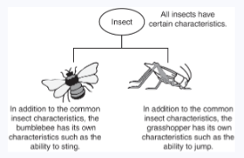
Inheritance: Generalization and Specialization
In the real world, you can find many objects that are specialized versions of other objects.
For example, the term “insect” describes a very general type of creature with numerous characteristics.
Because grasshoppers and bumblebees are insects, they have all the general characteristics of an insect.
In addition, they have special characteristics of their own.
For example, the grasshopper has its jumping ability, and the bumblebee has its stinger. Grasshoppers and bumblebees are specialized versions of an insect.

Slide 3
Inheritance and the Is-a Relationship
When one object is a specialized version of another object, there is an is-a relationship between them.
For example, a grasshopper is an insect.
When an is-a relationship exists between objects, it means that the specialized object has all of the characteristics of the general object, as well as additional characteristics that make it special.
In object-oriented programming, inheritance is used to create an is-a relationship between classes.

Slide 4
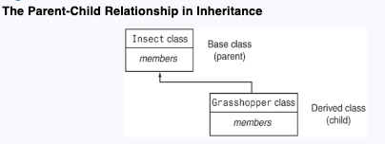
Inheritance and the Is-a Relationship
Inheritance involves a base class and a derived class.
The base class is the general class, and the derived class is the specialized class.
The derived class is based on, or derived from, the base class.
We can think of the base class as the parent and the derived class as the child.

Slide 5
Inheritance and the Is-a Relationship
The derived class inherits the member variables and member functions of the base class without any of them being rewritten.
Furthermore, new member variables and functions may be added to the derived class to make it more specialized than the base class.

Slide 6
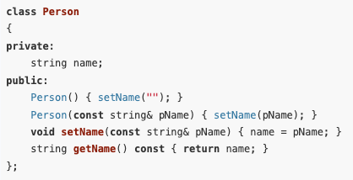
Inheritance and the Is-a Relationship
To take a specific example, consider a college or university environment where there are both students and faculty personnel.
Suppose that we have a class Person with a name data member and member functions for working with the name member

Slide 7
Inheritance and the Is-a Relationship
Suppose further that we have the enumerated types
To define the range of disciplines in which studies are offered and the classification of students.
We can use these types to define Student and Faculty classes that inherit from Person.
This makes sense because a Student is a Person and a Faculty member is also a Person.

Slide 8
Inheritance and the Is-a Relationship
To define a class by inheritance, we need to specify the base class plus the additional members the derived class adds to the base class.
Let’s say that in addition to having all the characteristics of a Person, a Student must declare a major in some discipline and have an academic advisor who is a Person.

Slide 9
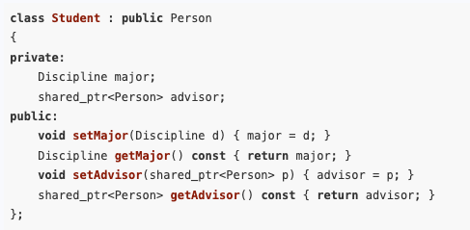
Inheritance and the Is-a Relationship
The Student class can be defined as follows:
We assume that many different students may have the same advisor.
The Student object stores a shared smart pointer to the advisor to avoid memory management problems.

Slide 10

Inheritance and the Is-a Relationship
The first part of the first line of the class declaration specifies Student as the name of the class being defined and specifies the existing class Person as its base class.
The key word public that precedes the name of the base class is the base class access specification.
It affects how the members of the base class will be accessed by the member functions of the derived class and by code outside of the two classes.

Slide 11
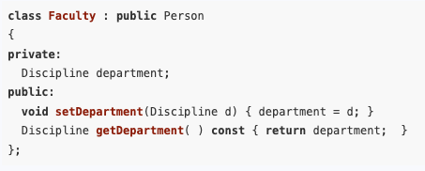
Inheritance and the Is-a Relationship
A class can be used as the base class for more than one derived class.
A Faculty class can also be derived from the Person class as follows:
Thus, a Faculty object is a Person object that has a home department in some discipline.

Slide 12
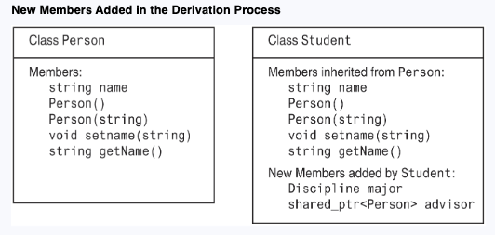
Inheritance and the Is-a Relationship
It is also important to note that each object of the derived class will contain all members of the base class.

Slide 13
Inheritance and Pointers
Whenever inheritance is involved, all objects should be dynamically allocated and accessed through pointers.
To see why, consider a program that works with both Student and Person types.
Because a Student is a Person, we should be able to pass Student objects to functions that expect a parameter of type Person or assign a Student object to a variable of type Person.
Person p;
Student s;
p = s;

Slide 14
Inheritance and Pointers
However, a Student object, with its additional members, will not fit in a memory location allocated for a Person object.
To carry out such an assignment, the compiler will slice off the Student parts that do not belong to Person, leaving only the inherited parts and resulting in loss of information.
This does not occur if we are dealing with pointers because all pointers have the same size.

Slide 15
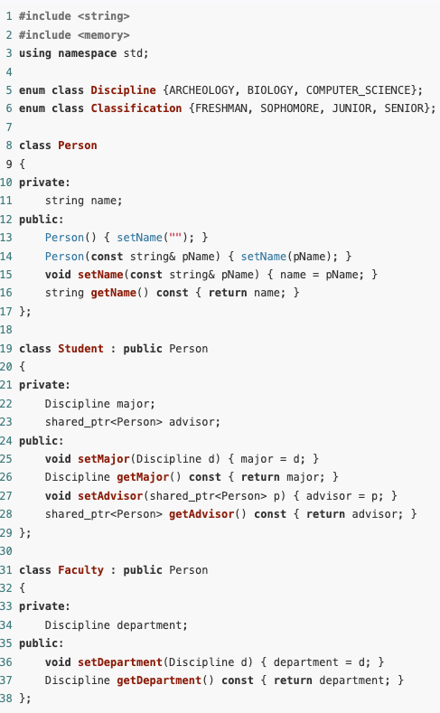
Inheritance and Pointers
This example demonstrates the creation and use of an object of a derived class by creating a Faculty object.
The program uses arrays of strings that map values of enumerated types to strings to enable printing of values of enumerated types in the form of strings.
The included “inheritance.h” file contains declarations of the Person, Student, and Faculty classes, as well as the enumerated types Discipline and Classification.

Slide 16
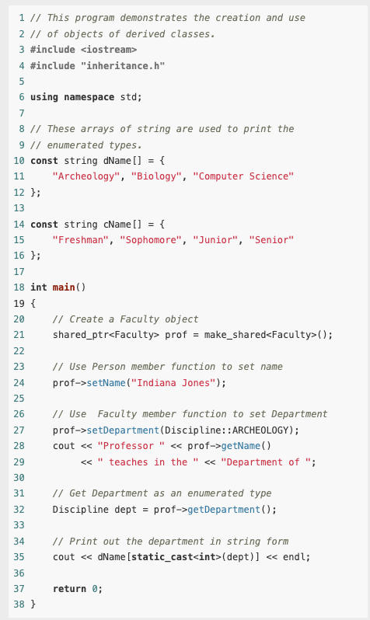
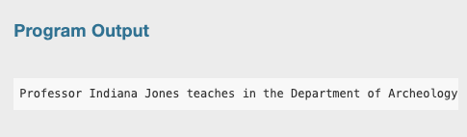
Inheritance and Pointers

Slide 17
Superclasses and Subclasses
We can think of a class as describing the set of all objects that have certain characteristics.
An object of a derived class inherits all the characteristics of the base class, so it can be regarded as belonging to the base class.
Thus, objects of the derived class are just specialized objects of the base class.
For this reason, the derived class is often called a subclass of the base class, and the base class is called a superclass of the derived class.

Slide 18
Protected Members and Class Access
Protected members of a base class are like private members, except they may be accessed by derived classes.
The base class access specification determines how private, protected, and public base class members are accessed when they are inherited by the derived class.

Slide 19
Protected Members and Class Access
Until now you have used two access specifications within a class: private and public.
C++ provides a third access specification, protected.
Protected members of a base class are like private members, except they may be accessed by member functions of a derived class.
Protected members are inaccessible to all other code in the program

Slide 20
Protected Members and Class Access
Until now you have used two access specifications within a class: private and public.
C++ provides a third access specification, protected.
Protected members of a base class are like private members, except they may be accessed by member functions of a derived class.
Protected members are inaccessible to all other code in the program

Slide 21
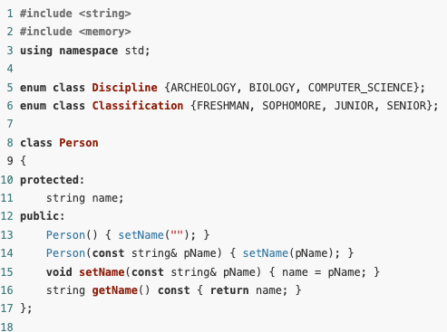
Example
Let us suppose we want to add to the Faculty class a constructor that takes as parameter the name and department of a professor.
The best way to accomplish this is to have the constructor call the setName() member function inherited from the Person class.
To see the use of protected members, however, we will change the access specification of the name field of the Person class to protected and have the Faculty constructor access it directly.

Slide 22
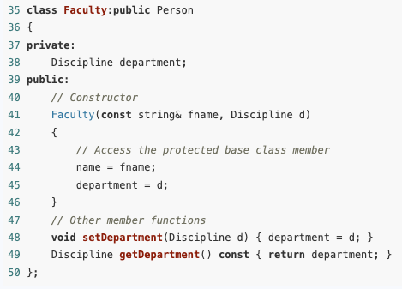
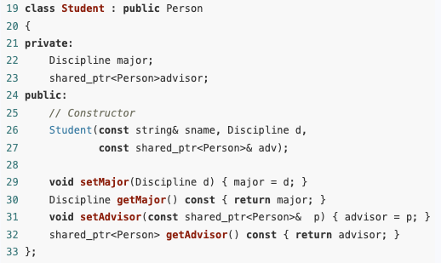
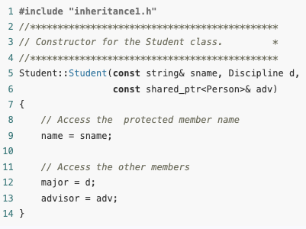
Example

Slide 23
Protected Members
Inheriting protected data members (data fields) slightly increases performance
We can directly access the members without activating set or get functions
But it breaks the data encapsulation; Better to use private data members
Derived class can depend on protected visibility member functions which are inherited
If the base-class implementation changes, it may affect all derived classes of that base class

Slide 24
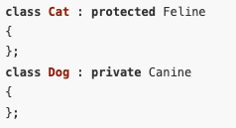
Base Access Specifications
In addition to public, C++ permits the use of protected and private as base access specifications

Slide 25
Base Access Specifications
Be careful not to confuse base access specification with member access specification.
Member access specification determines the type of access for members defined in the class, whereas base access specification determines the type of access for inherited members

Slide 26
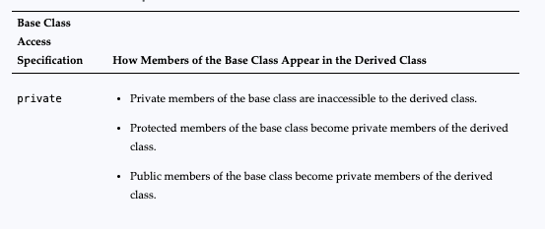
Base Access Specifications

Slide 27
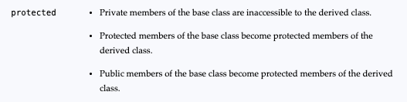
Base Access Specifications

Slide 28
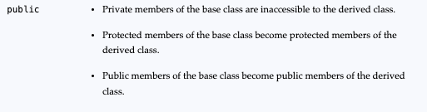
Base Access Specifications

Slide 29
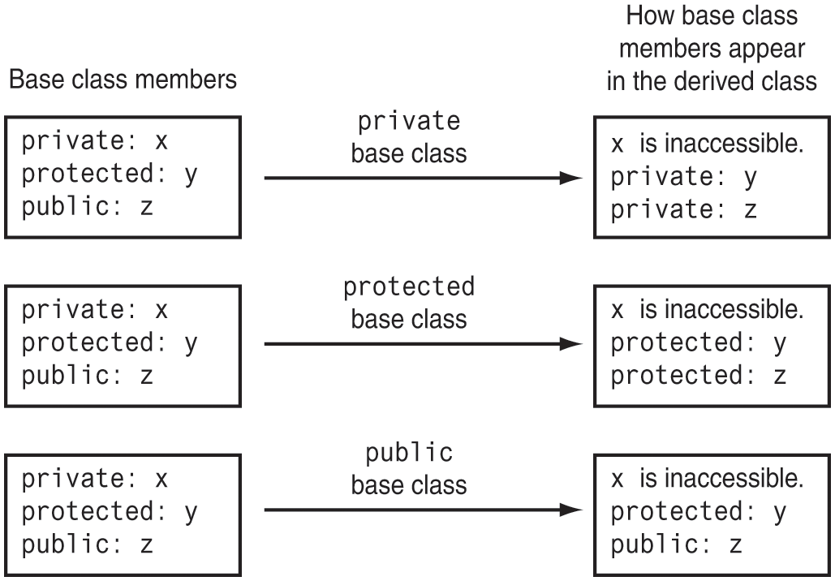
Base Access Specifications

Slide 30
Constructors, Destructors, and Inheritance
When an object of a derived class is being instantiated, the base class constructor is called before the derived class constructor.
When the object is destroyed, the derived class destructor is called before the base class destructor.

Slide 31
Constructors, Destructors, and Inheritance
We know that hat constructors are automatically called by the compiler whenever an object of a class is being created.
Because every object of a derived class can be regarded as having an object of the base class embedded within it, the creation of a derived class object involves the creation of the embedded base class object.
The compiler will always call the base class constructor before it calls the derived class constructor.

Slide 32
Constructors, Destructors, and Inheritance
This order is reversed upon destruction of a derived class object; the destructor in the derived class is called before the destructor in the base class.
This order permits the derived class constructors and destructors to use data or member functions of the base class in doing their work.

Slide 33
Constructors, Destructors, and Inheritance
Important to note that constructors, destructors, and overloaded assignment operators of the base class are not inherited by the derived class, regardless of the inheritance type.
Constructors, destructors, and overloaded assignment operators are not inherited because each derived class must define its own versions to handle specific initialization, destruction, or assignment needs.
The derived class can call the base class’s constructor, destructor, or assignment operator as needed to manage inherited resources.

Slide 34
Multiple Inheritance
C++ supports multiple inheritance in which a derived class simultaneously derives from two or more base classes.
Though interesting, multiple inheritance can lead to programs that are very difficult to understand and is rarely useful in practice.
We will not go through that in this semester.

Slide 35
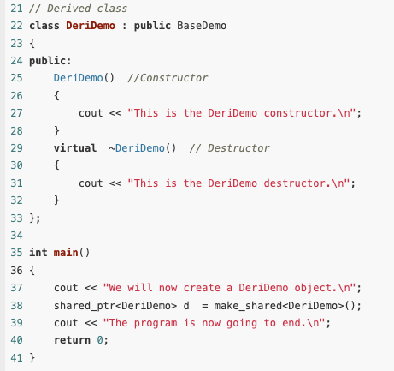
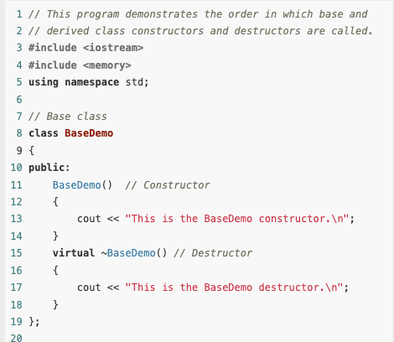
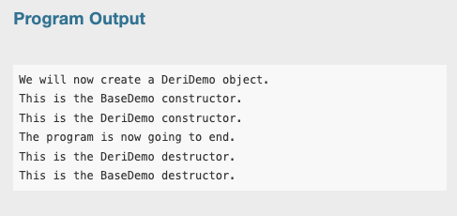
Example

Slide 36
Passing Arguments to Base Class Constructors
As already mentioned, the compiler will automatically call a base class constructor before executing the derived class constructor.
The compiler’s default action is to call the default constructor in the base class.
Some classes, however, may not have a default constructor.
Also, the programmer may want to specify which of several base class constructors should be called during the creation of a derived class object.

Slide 37
Passing Arguments to Base Class Constructors
In these cases, the programmer must explicitly specify which base class constructor should be called by the compiler.
This is done by specifying the arguments to the selected base class constructor in the definition of the derived class constructor.

Slide 38
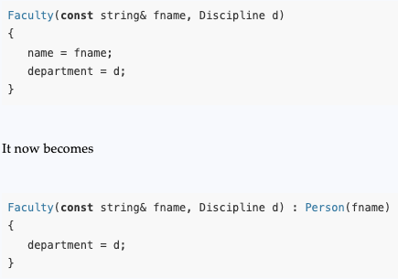
Passing Arguments to Base Class Constructors
The syntax for passing arguments to base class constructors is simple:
The header for the derived class constructor is followed by a colon, an indication of which base class constructor to call, and the arguments to be passed.
Example, we will modify the constructor for the Faculty class so that it invokes a constructor in the Person class.

Slide 39
Passing Arguments to Base Class Constructors
Notice that one of the arguments passed to the derived class constructor is passed to the base class constructor.
In general, the argument passed to the base class constructor may be any expression and may involve any variables that are in scope at the point of the call to the derived class constructor.
For example, a string literal, or even a global string variable, could have been passed as the argument to the Person constructor.

Slide 40
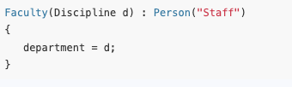
Passing Arguments to Base Class Constructors
If, for example, it was desired that the name of a faculty member default to that of the ubiquitous “Dr. Staff,” the following constructor would be just what we want:

Slide 41
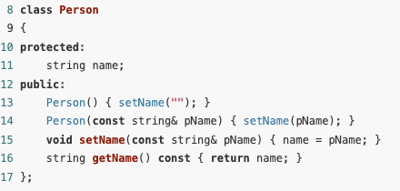
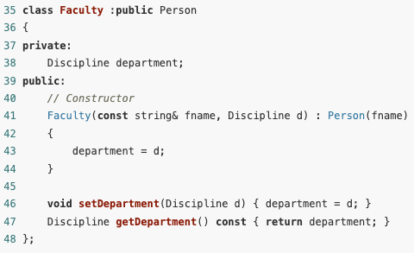
Example
It is important to remember that the arguments to the base class constructor must be specified in the definition of the derived class constructor, and not in its declaration.

Slide 42
Overriding Base Class Functions
A derived class can override a member function of its base class by defining a derived class member function with the same name and parameter list.
It is often useful for a derived class to define its own version of a member function inherited from its base class.
This may be done to specialize the member function to the needs of the derived class.
When this happens, the base class member function is said to be overridden, or redefined, by the derived class.

Slide 43
Overriding Base Class Functions
A derived class can override a member function of its base class by defining a derived class member function with the same name and parameter list.
It is often useful for a derived class to define its own version of a member function inherited from its base class.
This may be done to specialize the member function to the needs of the derived class.
When this happens, the base class member function is said to be overridden, or redefined, by the derived class.

Slide 44
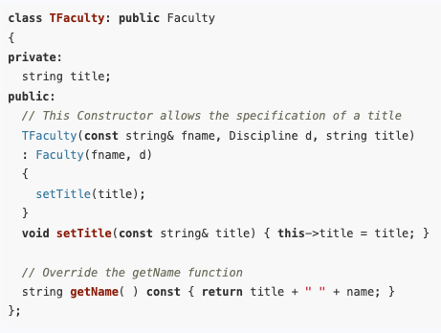
Overriding Base Class Functions
As a simple example, suppose that we want to have a class Tfaculty that will allow us to associate with each member of the faculty a title such as “Dr.,” “Professor,” or “Dean.”
To accomplish this, we derive the new class from the Faculty class by adding a title data member, an appropriate constructor, a member function to set the title, and then overriding the inherited getName() member function to return a “titled” name.

Slide 45
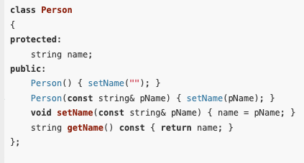
Overriding Base Class Functions

Slide 46
Choosing Between Base and Derived Class Versions of an Overriden Function
An object of a derived class that has overridden a base class member function contains more than one version of the member function.
The compiler will determine which of the several versions to call by using type information in the expression used to make the call to the member function.

Slide 47
Choosing Between Base and Derived Class Versions of an Overriden Function
For example, in our example, if there are two calls to getName():
If prof is an object of TFaculty, the call prof.getName() returns Dr. Indiana Jones because the function is called through prof, which has type TFaculty. The compiler calls the TFaculty version getName().
If the function is called through the pointer pAdvisor, which is a pointer to Person, the call pAdvisor−>getName() returns Indiana Jones without the “Dr.” because the function is called through the pointer pAdvisor, which is a pointer to Person. The compiler calls the Person version of getName().

Slide 48
The Difference Between Overloading and Overriding
Th overloading and overriding involve the definition of different functions with the same name.
There are differences between the two concepts, however.
Overriding can only be done in the context of inheritance and refers to the defining of a member function by a derived class when the base class already has a member function of the same name and parameter list.
Overloading refers to the definition of different functions within the same class with the same name and different parameter lists.
Overloading can also refer to the definition of different functions with different parameter lists at the global level.

Slide 49
Gaining Access to an Overridden Member Function
If a derived class overrides a base class member function, member functions of the derived class that would have otherwise called the overridden base class member function will now call the version in the derived class.
It is occasionally useful to be able to call the overridden version. In fact, the new member function of the derived class may want to call the base class member function that it is overriding.
This is done by using the scope resolution operator to specify the class of the overridden member function being accessed.

Slide 50
Gaining Access to an Overridden Member Function
If a derived class overrides a base class member function, member functions of the derived class that would have otherwise called the overridden base class member function will now call the version in the derived class.
It is occasionally useful to be able to call the overridden version.
In fact, the new member function of the derived class may want to call the base class member function that it is overriding.
This is done by using the scope resolution operator to specify the class of the overridden member function being accessed.
Person::getName();

Slide 51
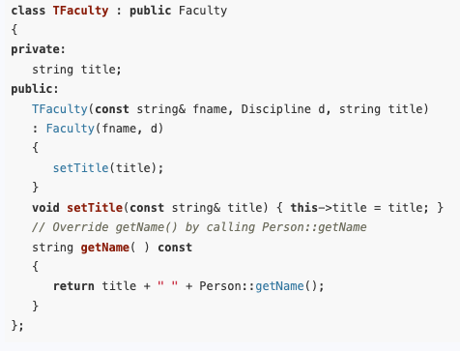
Gaining Access to an Overridden Member Function
Thus, a better version of the TFaculty class is the following.
Note that the overriding function does not need to access any protected members of Person, but instead calls the public member function getName.

Slide 52
Benefits of Inheritance
Software reusability
Code for the common behavior does not need to be rewritten for the child class
Improved reliability
Code in a parent class has been tested and is more likely to remain valid
Reduce maintenance
Once the super class has been corrected, code in all subclasses is updated

Slide 53
Benefits of Inheritance
Allow to cluster similar classes together
Help effective abstractions for large complex systems
Consistency of interface
Several classes inherit from the same superclass
Easier to guarantee that interfaces to similar objects are similar
Can use polymorphism; Increase productivity (Will learn in the next class)
The same operation behaves differently in different objects depending on the object’s implementation of it
Easiness of expandability

Slide 54
Cost of inheritance
Inheritance can increase interdependencies that make code more complex and harder to maintain
Execution speed
Inherited methods are slower than specialized code
Ex: Matching overriding method along the class hierarchy
Increasing program size
Reusable software components may include unnecessary behavior
Message-passing overhead than simple procedure call
Object has more attributes that means more time for stacking attributes before move control to other method

Slide 55
Improper use of Inheritance
Potential problems can be caused when we apply inheritance improperly
Decrease code comprehensibility
May give difficulties to a programmer who tries to follow a system’s execution by tracing methods execution
Increases maintenance
Users may need to examine two or more classes to determine the behavior of a single class
Inheritance can increase the dependencies between the code in the parent class and in subclasses

Slide 56
Inheritance guidelines
Don’t tempt to inherit a new class from a previous similar class while overridding unwanted operations in the subclass
Instead of artificially inheriting classes by overriding operations, factor out the shared features of the existing class and the new class to produce a third class
Avoid deep inheritance trees
The deeper they are, the more difficult to understand & implement
Define common structure, behavior, and relationships at the highest level in the inheritance hierarchy at which they are applicable
Classes relationship should always be able to pass the “is a” test
A subclass must maintain complete compatibility with its superclass

